Slide 1

Solving linear system
Gaussian Elimination and Partial Pivoting
不正经讲师：理科宅Hunt

Slide 2
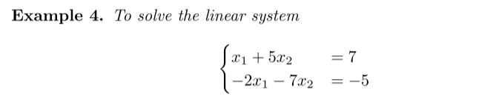

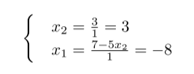
Gaussian Elimination – 高斯消元法
Elimination
Back substitution

Slide 3

Flops counting – 浮点数运算次数
证明略去了。。。。我知道你们肯定不会看的
$A$ is a $n×n$ matrix, to solve $A\vec{x}=\vec{b}$
Elimination: $O\left(\frac{2}{3}n^{3}\right)$
Back substitution: $n^{2}$
Total flops: $O\left(\frac{2}{3}n^{3}\right)$

Slide 4
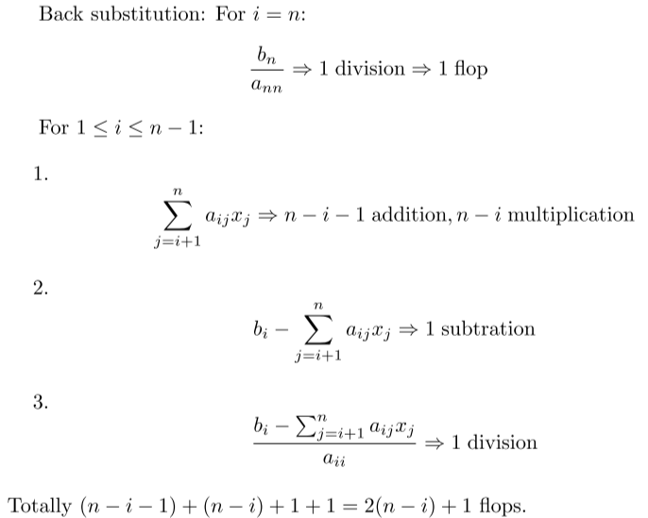
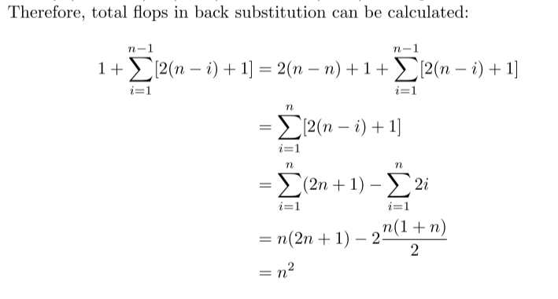
Flops counting – Back substitution

Slide 5
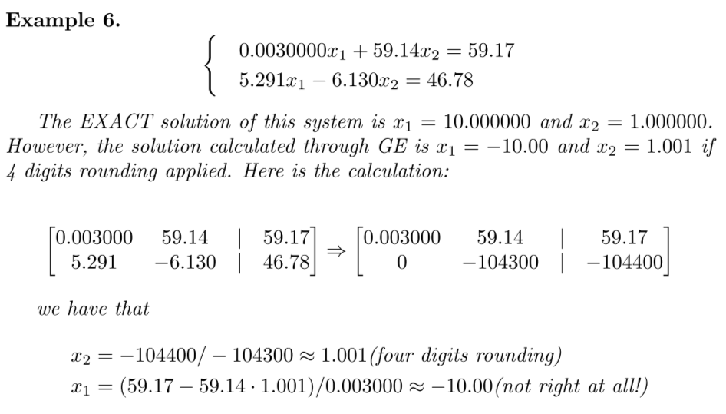
A serious error

Slide 6

Partial Pivoting – 我真不会翻译
会出错是因为出现了 “大/小” 的情况（division by a very small number）
要避免它，我们就要做换行
用第n行消走后面第n列n+1往后的数的时候，将第n列（从第n个数字开始往下看）拥有较大绝对值的行换到第n行

Slide 7
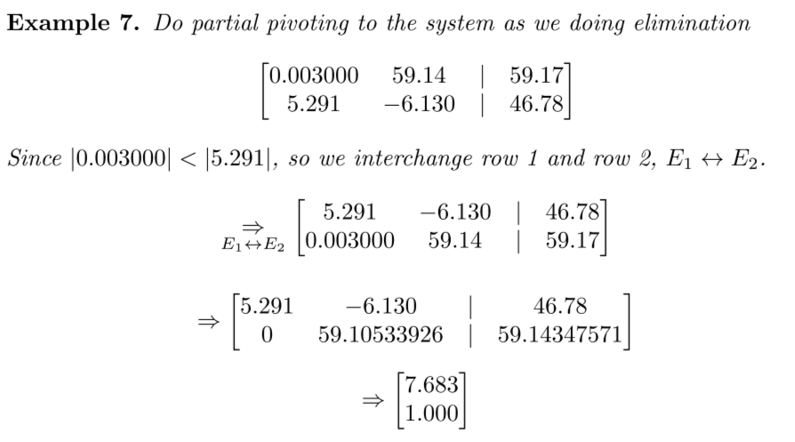
Example – 举个栗子

Slide 8

Condition number and error
Def: Condition number of a matrix $A$ is denoted as $κ(A)$
Theorem: Relative error in the result is proportional to $κ(A)$.
误差只跟矩阵$A$有关。
我算得不好怎么想都是题目的错！

Slide 9
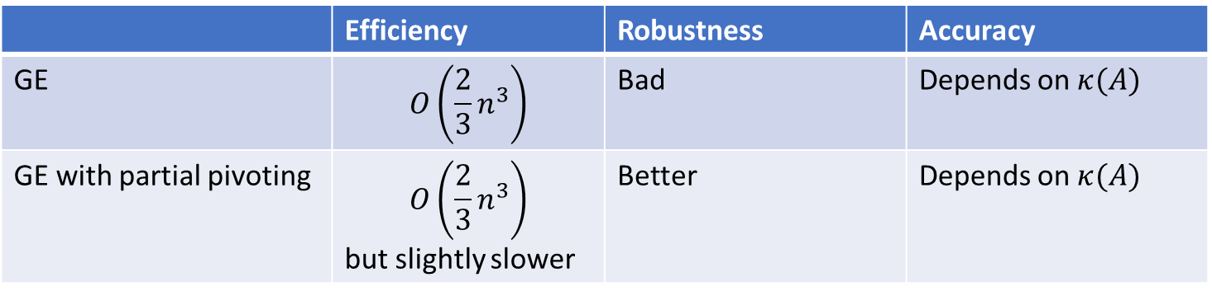
Conclusion – 总结
 | Efficiency | Robustness | Accuracy
GE | $$O\left({\frac{2}{3}n}^{3}\right)$$ | Bad | Depends on $κ(A)$
GE with partial pivoting | $$O\left({\frac{2}{3}n}^{3}\right)$$ but slightly slower | Better | Depends on $κ(A)$

